Slide 1



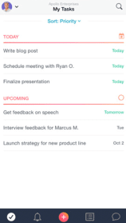
Bug Reporting:
Presenter: Sidra
Target Audience: Game Analysts

Slide 2

Outline
How is a bug independent/dependent
Bug Reporting Elements
Tags in Reported Bugs
Questions Session

Slide 3
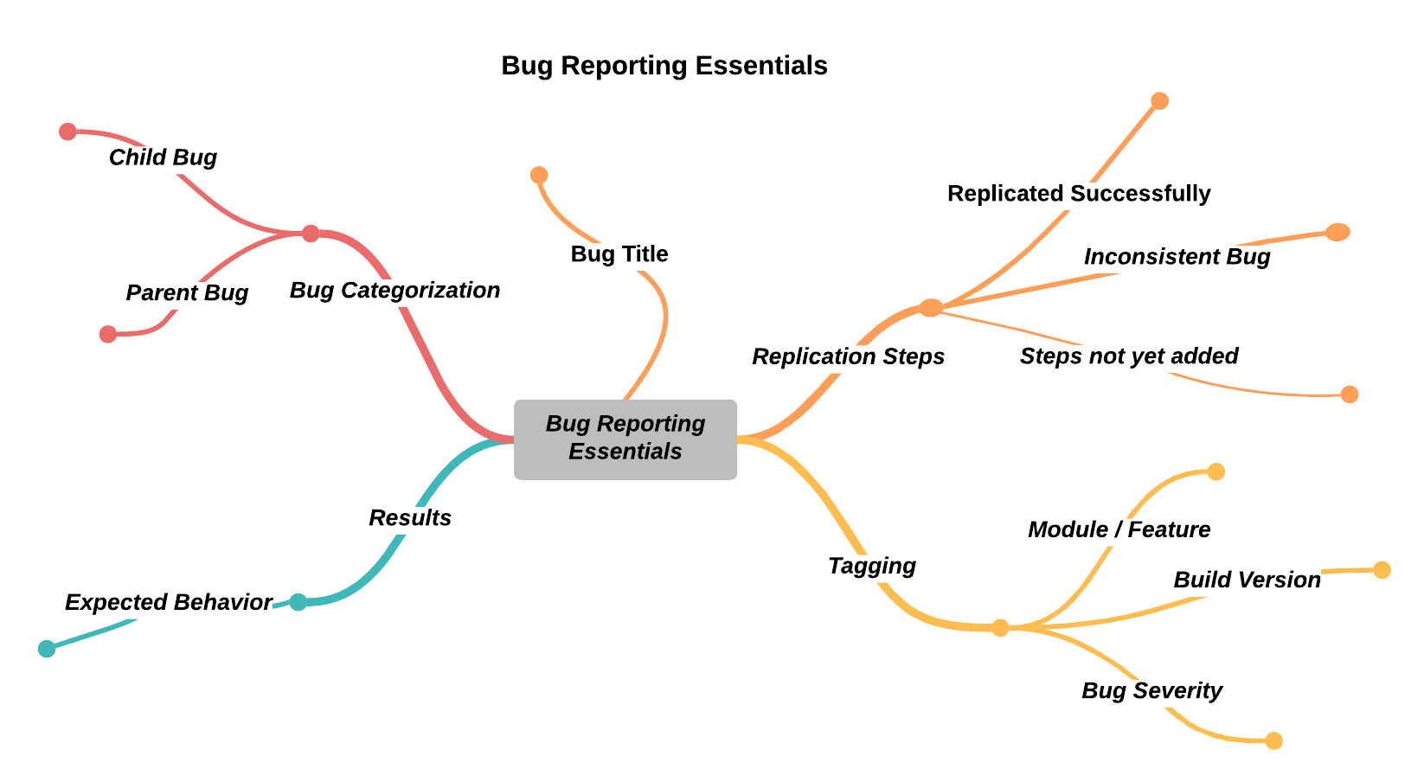

Slide 4

Independent & Dependent Bugs
Independent Bug:
Bugs that do NOT exist because of other bugs
They exist on their own
Always create a new entry for them on reporting tool
Dependent Bug:
Exist as result of another (Parent) bug
If parent bug is fixed they are fixed
Better to find parent bug entry and create this child bug as its subtask
Notes:
If the QA is not sure if a bug is independent or dependent it is safe to create a new entry on the tool (like parent).

Slide 5

Bug Reporting Elements
Bug reporting include follows:
Categorization (as Parent or child)
Bug Title
Bug Summary (opt)
Replication Steps
Expected Result
Test Data (opt)
Reference images & videos (opt)
Bug Assignment
Tags

Slide 6
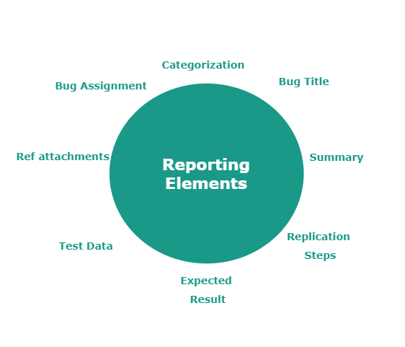
Categorization
Identify bug as independent or dependent
Create tool entry according to it
Adding bug title
This should be specific and not generic
Write actual bug and not feature/module name
Try to be precise
Bug summary (opt)
If you feel title is not enough, add a summary in description
Ensure bug is written to satisfaction
Try to be precise
Notes:
Bug Title & Bug Summary: It is better to be precise but it is more important to fully explain the bug.

Slide 7
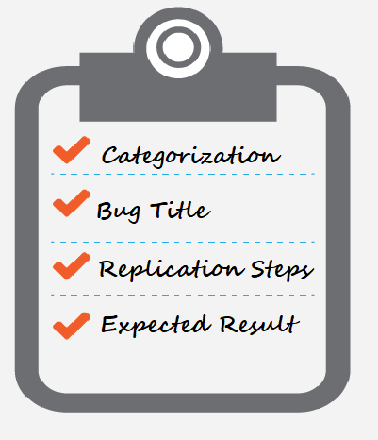
Replication steps
Give it a heading for clarity
Write pre-conditions, steps/actions to get bug as a list of steps
Replication Steps on the basis of Bug’s Type: - Inconsistent - Replicated successfully - Replication Steps not yet tried
Expected result
Write the expected/correct behaviour when replication steps are performed
Focus more on main difference in results and less on other details.
Notes:
Replication Steps on the basis of Bug’s Type: - Inconsistent (not getting replicated, mention cases you tried for that) - Replicated successfully (add replication steps) - Replication Steps not yet tried- (pending on QA end, mention when will you add them)

Slide 8

Test Data (Opt)
If bug is with specific users/items etc mention them.
Reference Images & Videos (opt)
Some bugs are easy to explain through pictures or videos
Attach them to task; verify attachments.
Make a G-drive folder for project, upload there and share link on task. Make sure attachments are accessible.
Assign the bug
If you know the developer who worked on that feature, assign to him/her
Otherwise assign to PM or Lead engineer. Ask PM if not sure.

Slide 9


Tags
Add the following tags:
Module/feature
Critical/major/medium/minor (Bug severity)
Build version / Build date
Testing Platform (conditional)
Bug /Polish (conditional)
Notes:
How many tags are required can vary for projects. PM can specify. But all unconditional should be added.
Tag for bug/polish can be PM’s choice.
For bugs related to more than one feature/module, add the tags of all features it falls into so relevant engineer can easily filter them.
Build version / Build date (based on what the project is using)
Only PMs best know if a bug is polish. In such cases where you’re not sure, add as a bug and discuss with PM.
Platform tag is not required if there is only one platform. Hence conditional.

Slide 10
THANK YOU!
“A good Bug Report Can Save Time By Avoiding Miscommunication Or The Need for Additional Communication.”

Slide 11

Questions Session

